Slide 1
Measures of Central Tendency (2)
Md. Ismail Hossain Riday

Slide 2
Descriptive measures
In previous chapter, we discussed how a raw data set can be organized and summarized by tables and graphs.
Another method of summarizing data set precisely is to compute number (a single number).
Number that can be describe data sets are called descriptive measures

Slide 3
Median
Middle value of the observation.
After they have been arranged/ordered from smallest to largest.

Slide 4

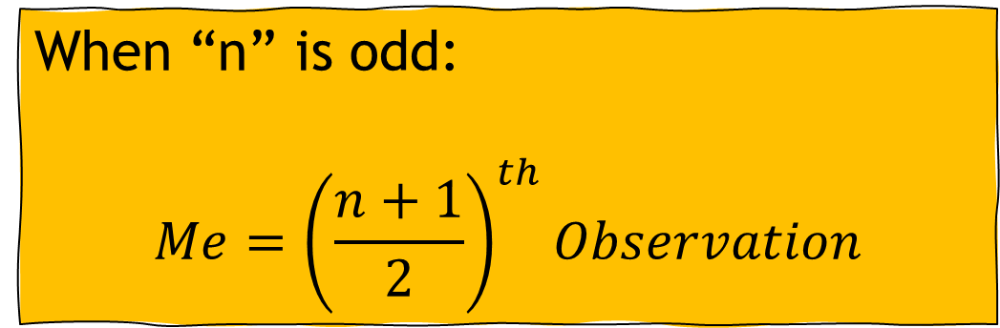
Median for Ungrouped data
There are two types of formula for ungrouped data
When “n” is odd:
$$Me={\left(\frac{n+1}{2}\right)}^{th}Observation$$
When “n” is even:
$$Me=\frac{{\left(\frac{n}{2}\right)}^{th}Obs.+{\left(\frac{n}{2}+1\right)}^{th}Obs.}{2}$$

Slide 5
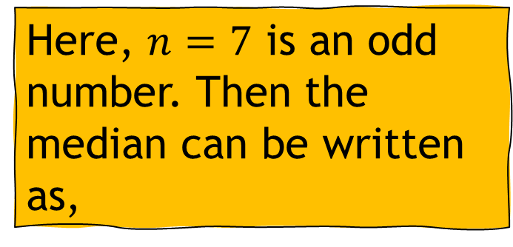
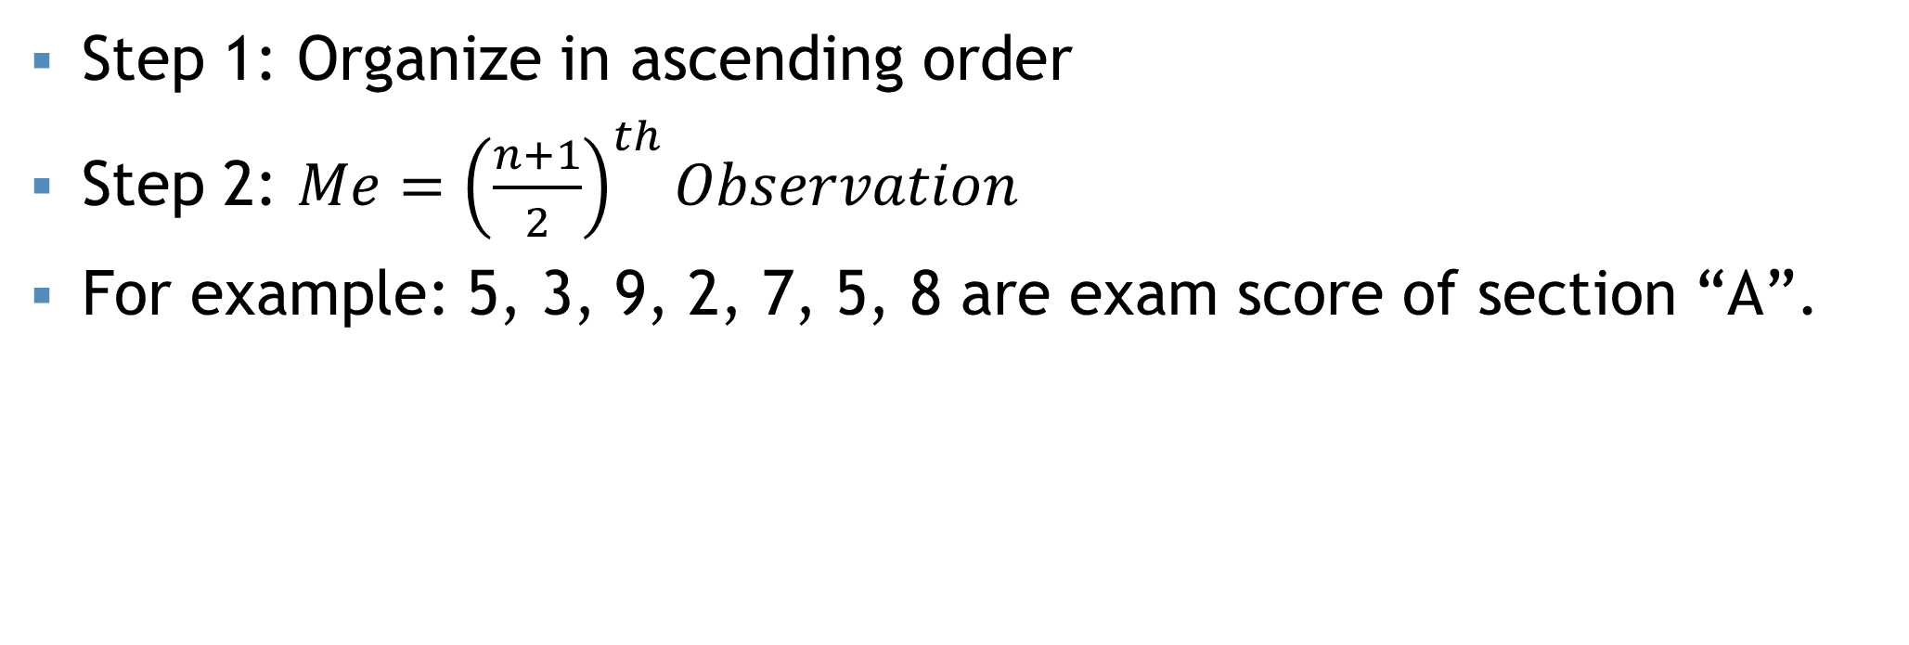

“n” is odd
Step 1: Organize in ascending order
Step 2: $Me={\left(\frac{n+1}{2}\right)}^{th}Observation$
For example: 5, 3, 9, 2, 7, 5, 8 are exam score of section “A”.
Organize in ascending order:
2, 3, 5, 5, 7, 8, 9
Here, $n=7$ is an odd number. Then the median can be written as,
$$Me={\left(\frac{n+1}{2}\right)}^{th}Obs.$$
$$∴Me=5$$
Comment: The median score of section “A” is 5

Slide 6
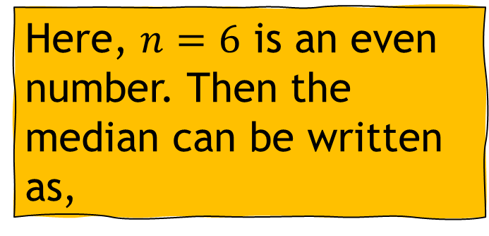
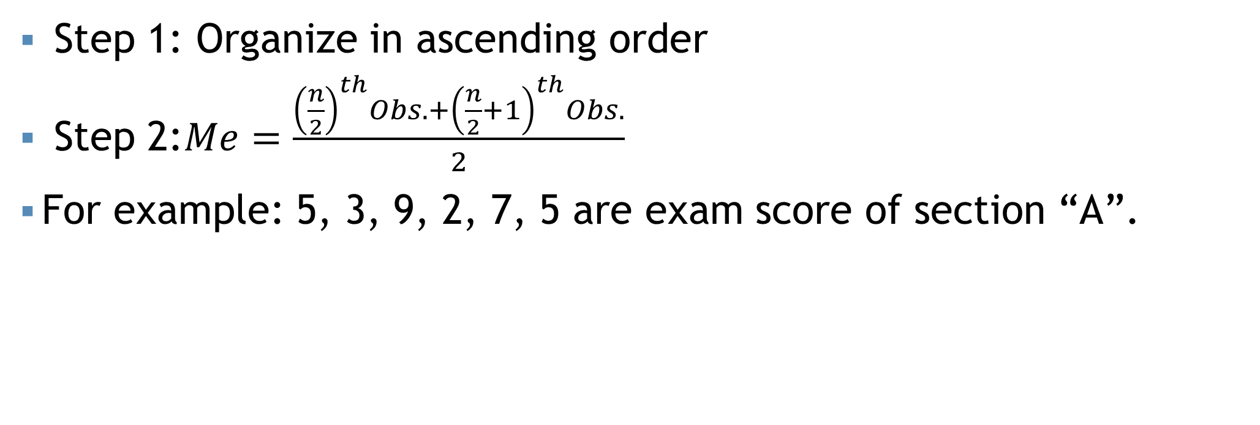

“n” is even
Step 1: Organize in ascending order
Step 2:$Me=\frac{{\left(\frac{n}{2}\right)}^{th}Obs.+{\left(\frac{n}{2}+1\right)}^{th}Obs.}{2}$
For example: 5, 3, 9, 2, 7, 5 are exam score of section “A”.
Organize in ascending order:
2, 3, 5, 7, 8, 9
Here, $n=6$ is an even number. Then the median can be written as,
$$Me=6$$
Comment: The median score of section “A” is 6

Slide 7
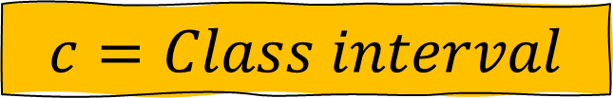
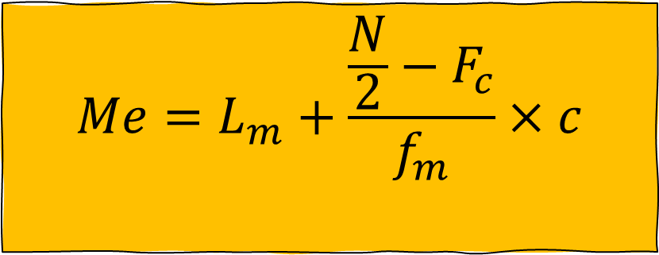
Median for grouped data
$$Me=L_{m}+\frac{\frac{N}{2}−F_{c}}{f_{m}}×c$$
$$L_{m}=Lower limit of median class$$
$$N=Total number of observations$$
$$F_{c}=Cumultative frequency of pre−median class$$
$$f_{m}=Frequency of median class$$
$$c=Class interval$$

Slide 8
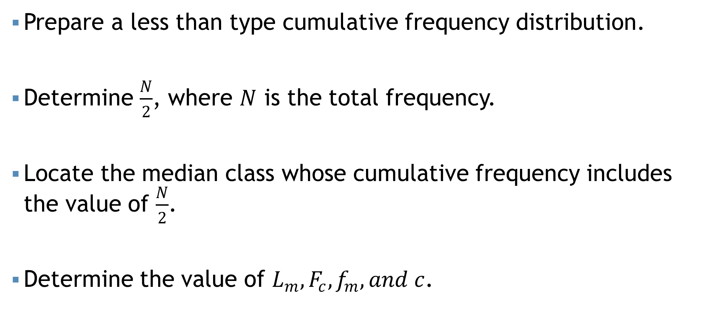
Steps…
Prepare a less than type cumulative frequency distribution.
Determine $\frac{N}{2}$, where $N$ is the total frequency.
Locate the median class whose cumulative frequency includes the value of $\frac{N}{2}$.
Determine the value of $L_{m},F_{c},f_{m}, and c$.

Slide 9
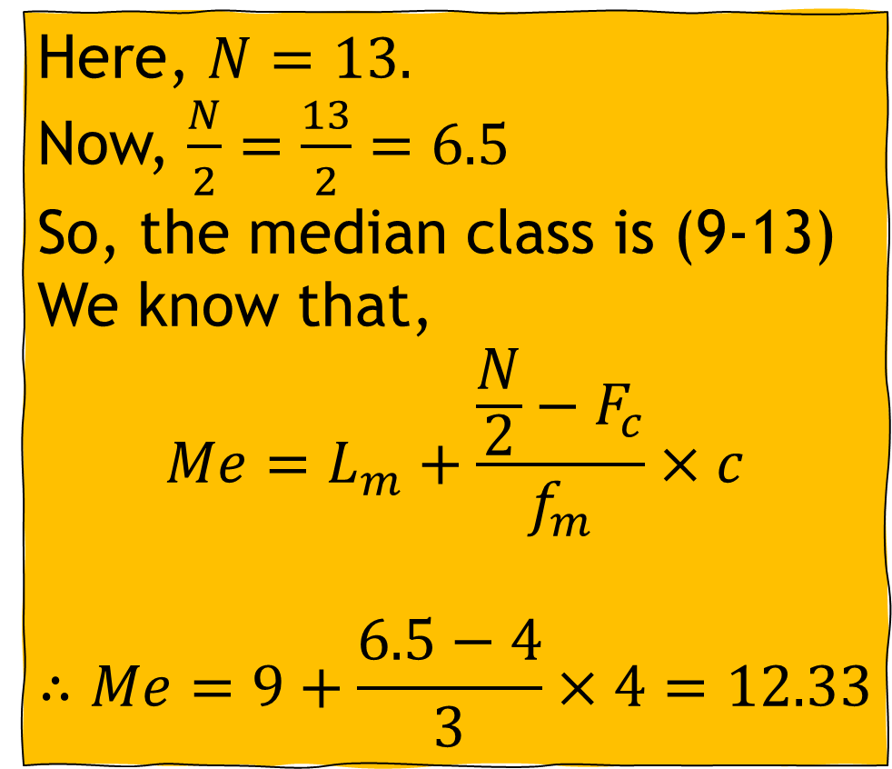
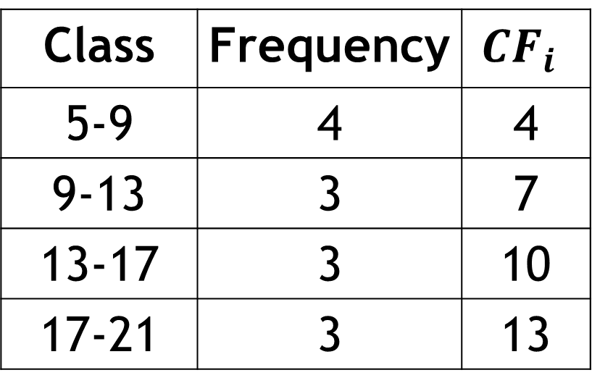
Median for grouped data
Class | Frequency | $$CF_{i}$$
5-9 | 4 | 4
9-13 | 3 | 7
13-17 | 3 | 10
17-21 | 3 | 13
Here, $N=13.$
Now, $\frac{N}{2}=\frac{13}{2}=6.5$
So, the median class is (9-13)
We know that,
$$Me=L_{m}+\frac{\frac{N}{2}−F_{c}}{f_{m}}×c$$
$$∴Me=9+\frac{6.5−4}{3}×4=12.33$$

Slide 10
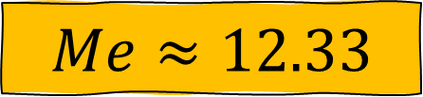
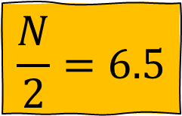
Median from graph
$$\frac{N}{2}=6.5$$
$$Me≈12.33$$

Slide 11
Mode
One mode = Unimodal
Two mode = Bi-modal
More than two = Multimodal
Most frequent value
Occurs more than one times.
For example: 1, 2, 2, 5, 5, 3, 6, 6, 6, 4
Here the most frequent value is 6.
Thus the mode value is 6, and this is a unimodal data.

Slide 12
Mode
Example: 1, 2, 3, 4, 5, 6, 7, 8, 9, 10
There is no value which occur more than one time. Thus there is no “Mode” in this data set.

Slide 13
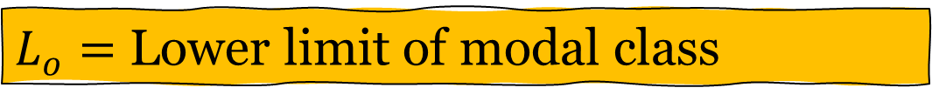
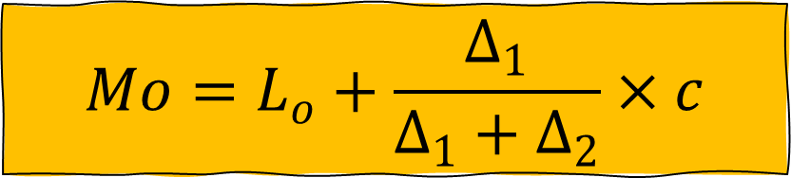
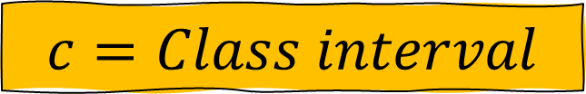
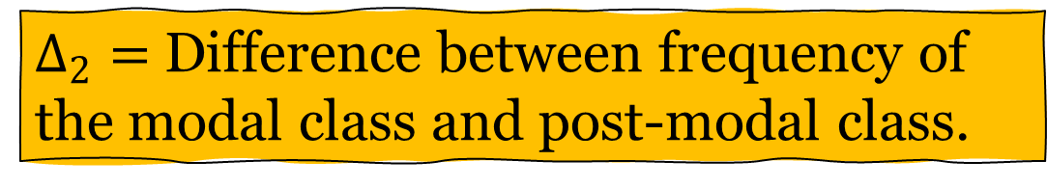
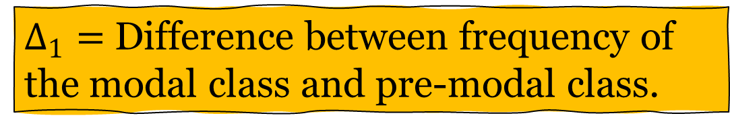
Mode for grouped data
$$Mo=L_{o}+\frac{Δ_{1}}{Δ_{1}+Δ_{2}}×c$$
$L_{o}=$ Lower limit of modal class
$Δ_{1}=$ Difference between frequency of the modal class and pre-modal class.
$Δ_{2}=$ Difference between frequency of the modal class and post-modal class.
$$c=Class interval$$

Slide 14
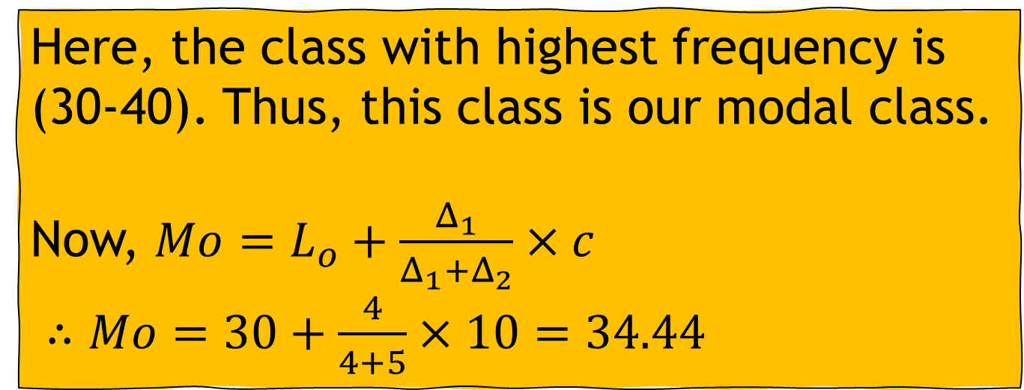
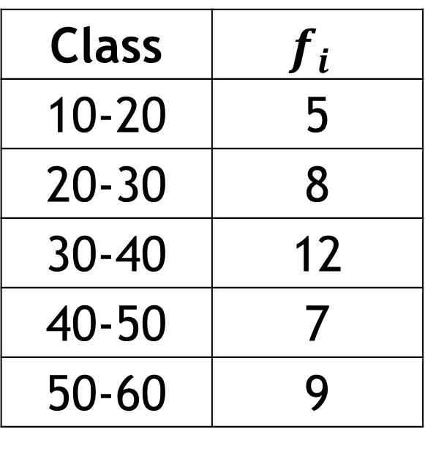
Mode for grouped data
Class | $$f_{i}$$
10-20 | 5
20-30 | 8
30-40 | 12
40-50 | 7
50-60 | 9
Here, the class with highest frequency is (30-40). Thus, this class is our modal class.
Now, $Mo=L_{o}+\frac{Δ_{1}}{Δ_{1}+Δ_{2}}×c$
$∴Mo=30+\frac{4}{4+5}×10=34.44$

Slide 15
Some points…
Does all data have a Mean, median, and mode?
Every set of continuous data possesses a median, mode, and mean.
When considering ordinal data, it encompasses solely a median and mode.
Nominal data solely involves a mode

Slide 16
Measures of Location
We have learned that median divided a set of data into two equal parts.
In the same way, we can divides a set of data into
Four equal parts
Ten equal parts
Hundred equal parts
Quartiles
Deciles
Percentiles

Slide 17
Q, D, and P
Quartiles: Divide the data set into four equal parts. So, we get 3 quartile points: Q1, Q2, and Q3
Deciles: Divide the data set into ten equal parts. So, we get 9 decile points: D1, D2, D3, … , D9.
Percentiles: Divide the data set into hundred equal parts. So, we get 99 percentile points: P1, P2, P3, … , P99

Slide 18
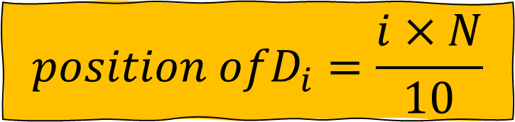
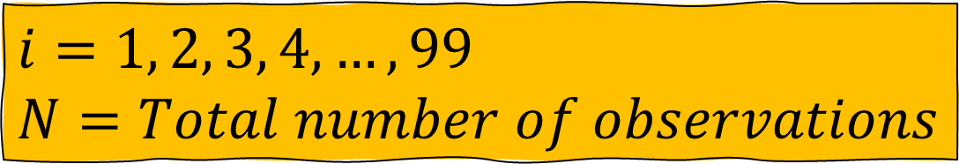
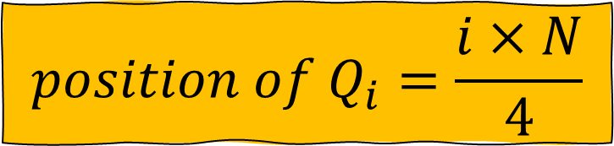
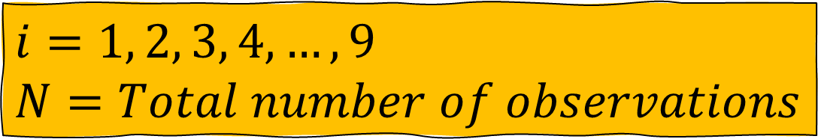
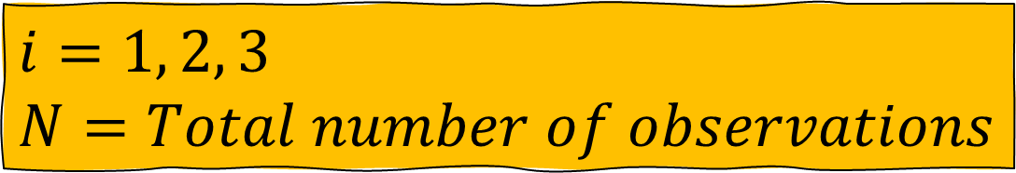
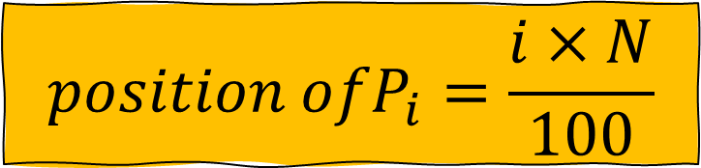
Q, D, and P (Ungrouped)
$$position of Q_{i}=\frac{i×N}{4}$$
$i=1, 2, 3$
$N=Total number of observations$
$${position ofD}_{i}=\frac{i×N}{10}$$
$i=1, 2, 3, 4, …,9$
$N=Total number of observations$
$${position ofP}_{i}=\frac{i×N}{100}$$
$i=1, 2, 3, 4, …,99$
$N=Total number of observations$

Slide 19
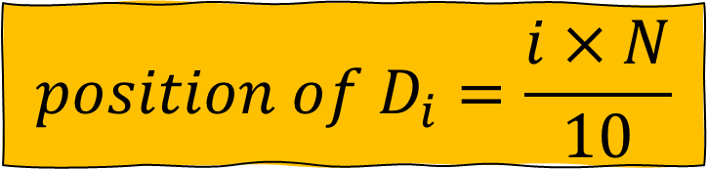
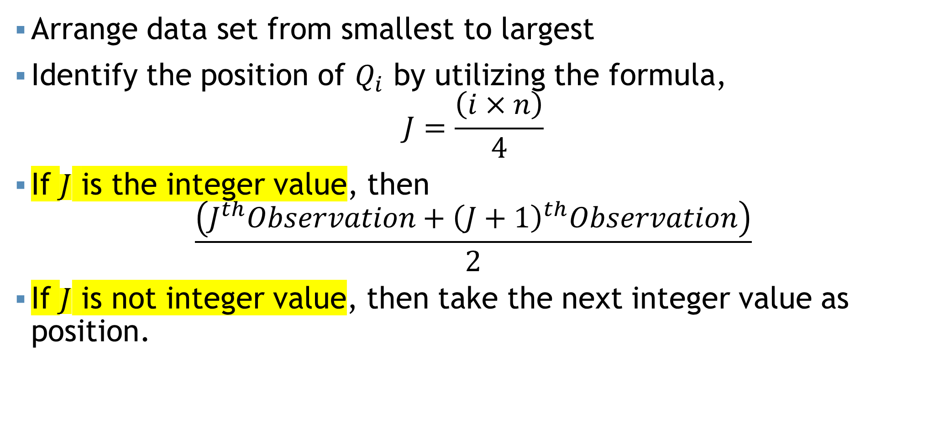
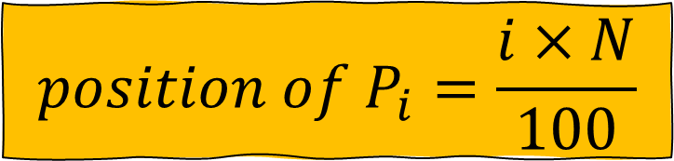
Steps…
$$position of D_{i}=\frac{i×N}{10}$$
$$position of P_{i}=\frac{i×N}{100}$$
Arrange data set from smallest to largest
Identify the position of $Q_{i}$ by utilizing the formula,
$$J=\frac{\left(i×n\right)}{4}$$
If $J$ is the integer value, then
$$\frac{\left(J^{th}Observation+{\left(J+1\right)}^{th}Observation\right)}{2}$$
If $J$ is not integer value, then take the next integer value as position.

Slide 20
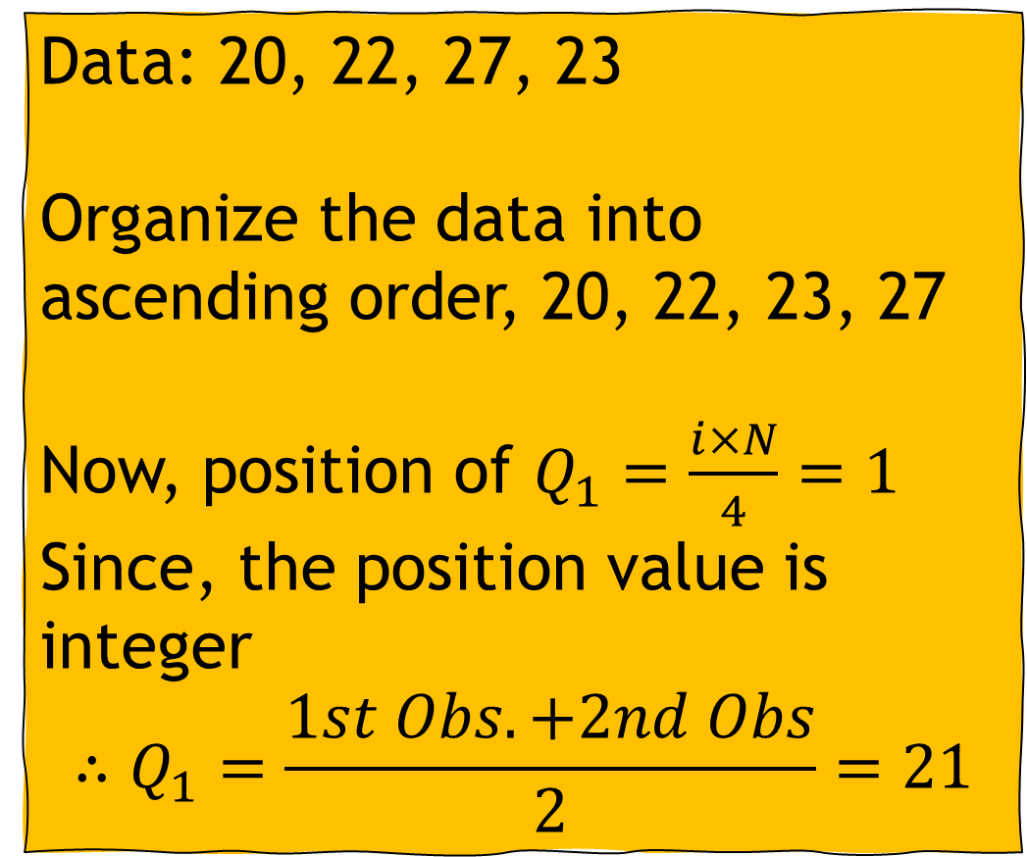
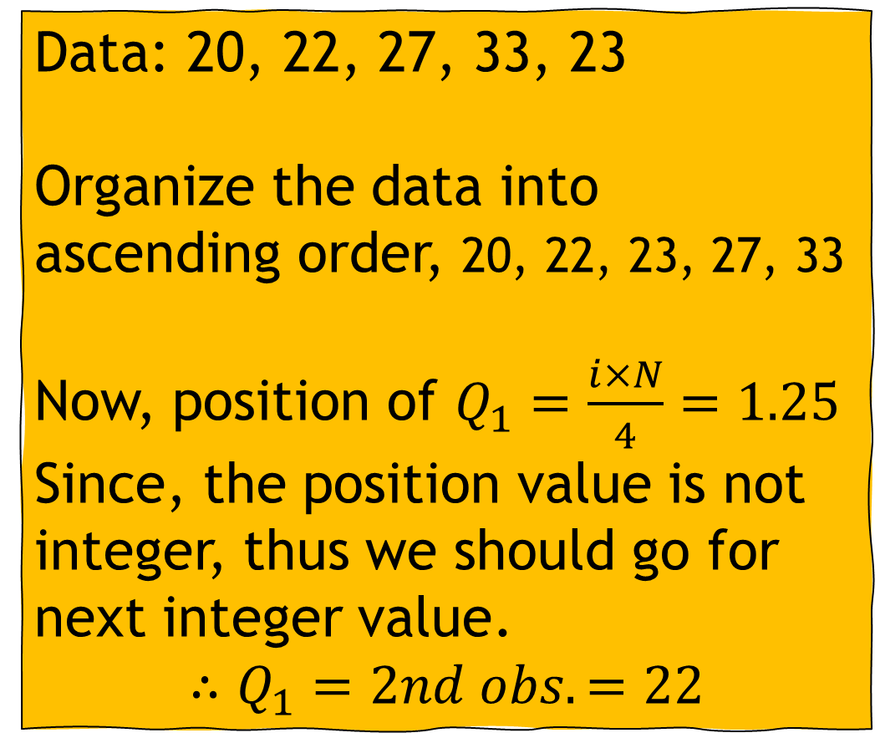
Example (Ungrouped)
Data: 20, 22, 27, 33, 23
Organize the data into ascending order, 20, 22, 23, 27, 33
Now, position of $Q_{1}=\frac{i×N}{4}=1.25$
Since, the position value is not integer, thus we should go for next integer value.
$$∴Q_{1}=2nd obs.=22$$
Data: 20, 22, 27, 23
Organize the data into ascending order, 20, 22, 23, 27
Now, position of $Q_{1}=\frac{i×N}{4}=1$
Since, the position value is integer
$$∴Q_{1}=\frac{1st Obs. +2nd Obs}{2}=21$$

Slide 21

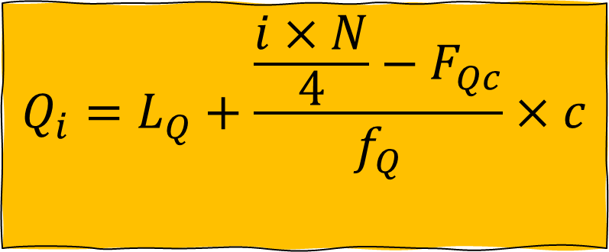
Q, D, and P (Grouped)
$$Q_{i}=L_{Q}+\frac{\frac{i×N}{4}−F_{Qc}}{f_{Q}}×c$$
$$L_{Q}=Lower limit of quartile class$$
$$N=Total number of observations$$
$$F_{c}=Cumultative frequency of pre−quartile class$$
$$f_{Q}=Frequency of quartile class$$
$$c=Class interval$$

Slide 22
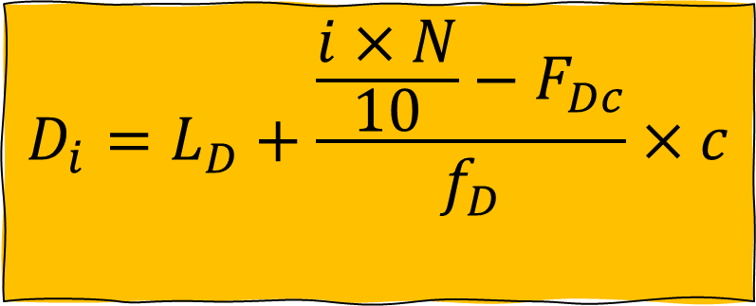
Q, D, and P (Grouped)
$$D_{i}=L_{D}+\frac{\frac{i×N}{10}−F_{Dc}}{f_{D}}×c$$
$$L_{D}=Lower limit of decile class$$
$$N=Total number of observations$$
$$F_{c}=Cumultative frequency of pre−decile class$$
$$f_{D}=Frequency of decile class$$
$$c=Class interval$$

Slide 23
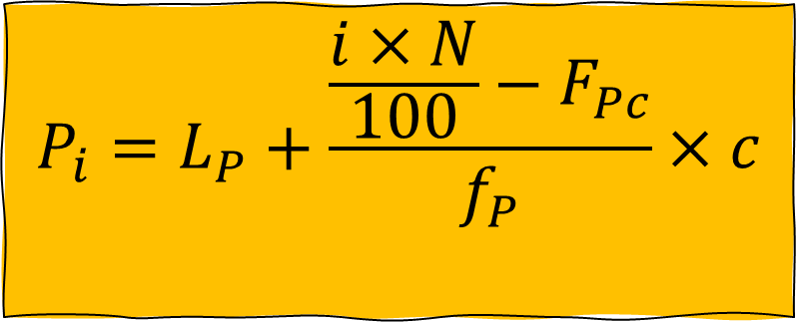
Q, D, and P (Grouped)
$$P_{i}=L_{P}+\frac{\frac{i×N}{100}−F_{Pc}}{f_{P}}×c$$
$$L_{P}=Lower limit of percentile class$$
$$N=Total number of observations$$
$$F_{c}=Cumultative frequency of pre−percentile class$$
$$f_{P}=Frequency of percentile class$$
$$c=Class interval$$

Slide 24

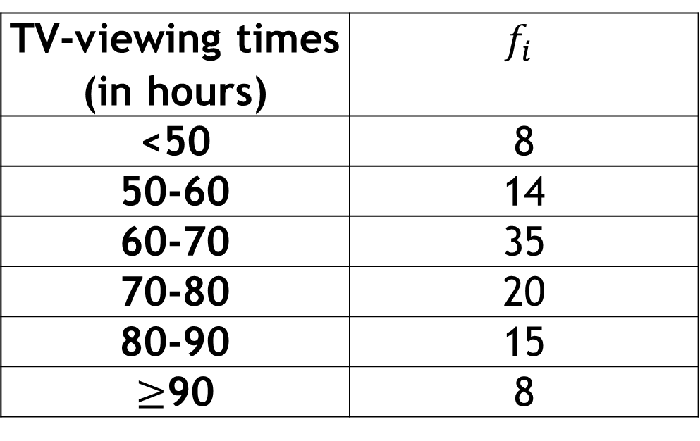
Self Practice
$$\text{Determine} Q_{1}, Q_{2}, and Q_{3} \text{with} \text{interpretation}\text{.}$$
A social organization publishes information on the TV-viewing habits of Bangladeshi garments workers in a report on Television. A sample of 100 garments workers yielded the monthly viewing times, in hours, displayed on the table,
Ans: 60.9, 68, and 79
TV-viewing times (in hours) | $$f_{i}$$
<50 | 8
50-60 | 14
60-70 | 35
70-80 | 20
80-90 | 15
$≥$90 | 8

Slide 25
Mathematical exercise
To access additional mathematical problems, please refer to the PDF lecture notes.

Slide 26
Thank You

